Slide 1
What a Wonderful World
by Louis Armstrong and Kenny G from the album Classics in the Key of G
ENJOY!

Slide 2
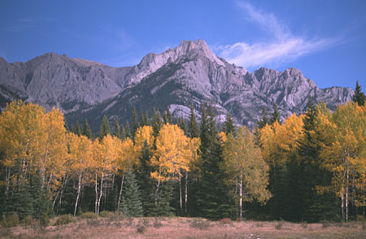


Slide 3
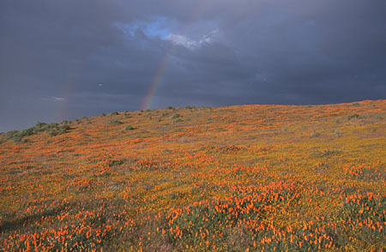

Slide 4


Slide 5
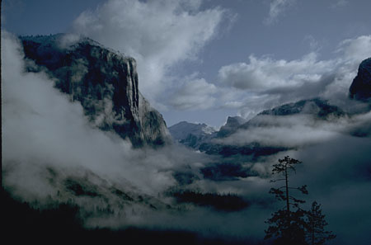

Slide 6
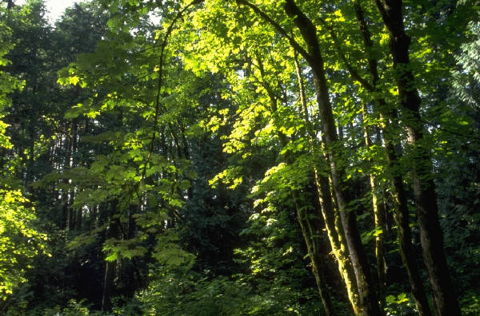
I see trees of green,

Slide 7

red roses too

Slide 8

I see them bloom for me and you

Slide 9
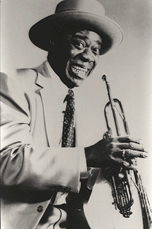
And I think to myself,

Slide 10
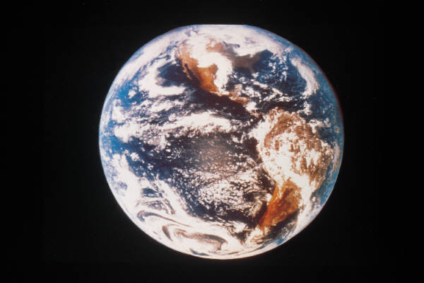
what a wonderful world

Slide 11
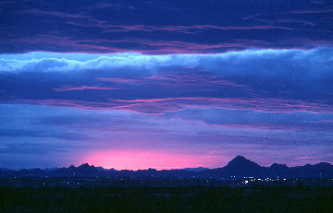
I see skies of blue

Slide 12

and clouds of white

Slide 13
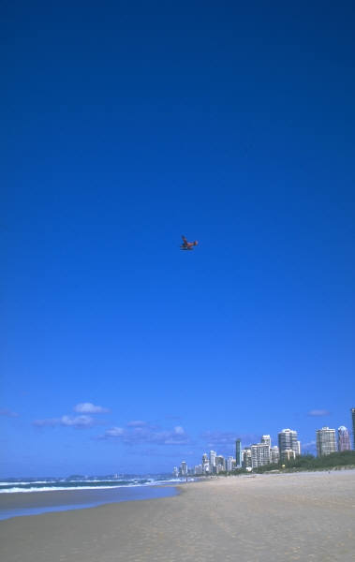
The bright blessed day,

Slide 14

the dark sacred night

Slide 15
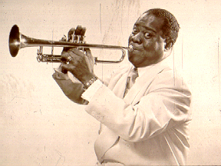
And I think to myself,

Slide 16
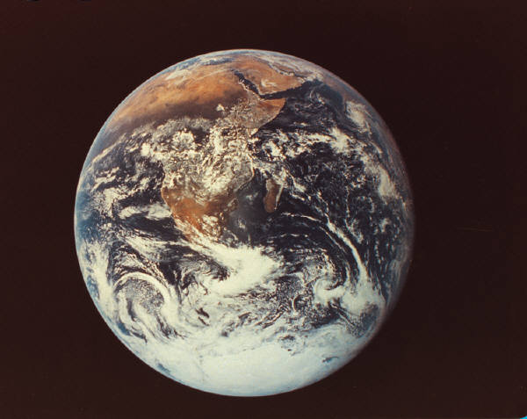
what a wonderful world

Slide 17
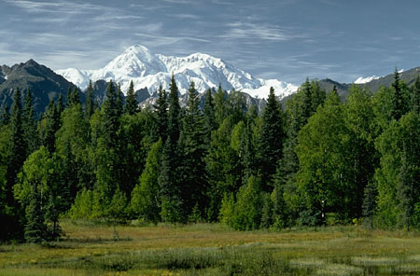

Slide 18


Slide 19
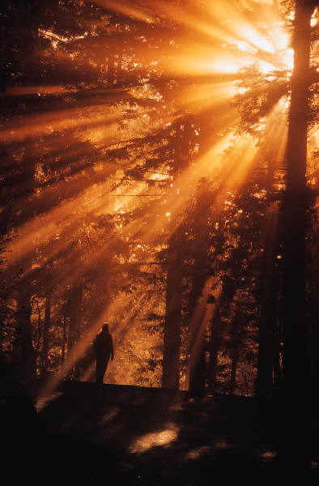

Slide 20


Slide 21
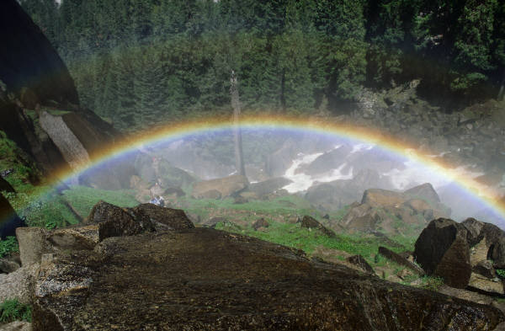

Slide 22
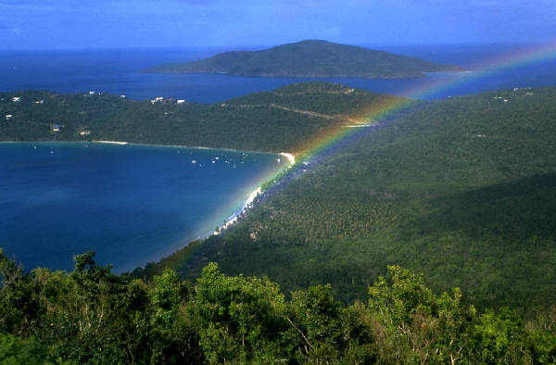
The colors of the rainbow,

Slide 23
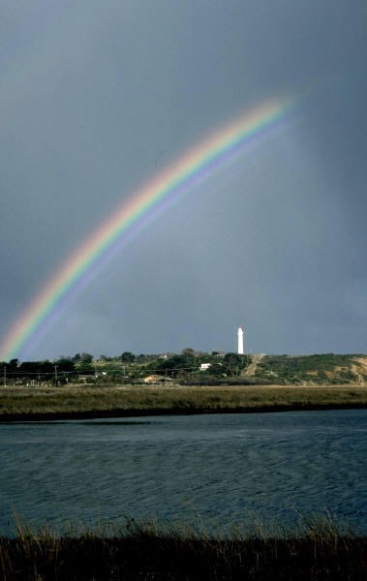
so pretty in the sky

Slide 24
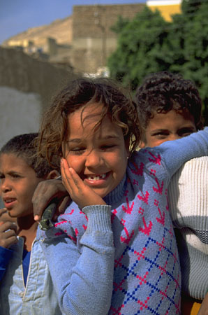
Are also on the faces

Slide 25
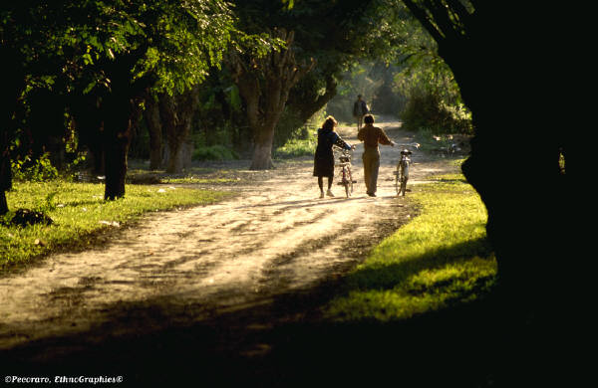
of people going by

Slide 26

I see friends shakin' hands,

Slide 27
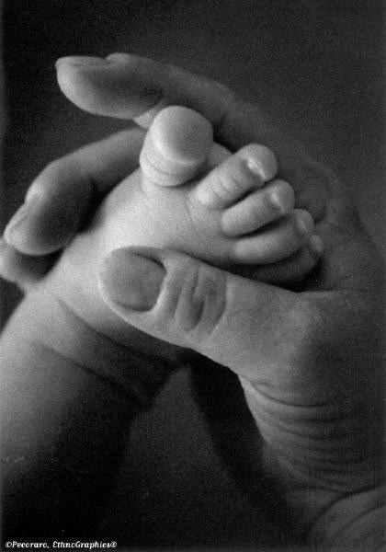
sayin' "How do you do?"

Slide 28

They're really saying "I love you”

Slide 29

I hear babies cryin',

Slide 30
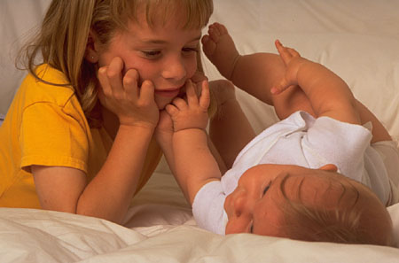
I watch them grow

Slide 31
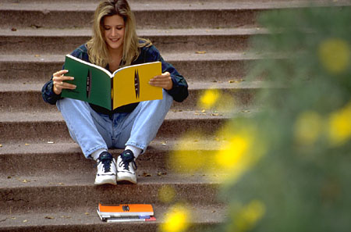
They'll learn much more

Slide 32
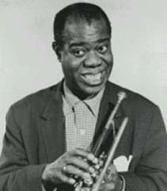
than I'll ever know

Slide 33
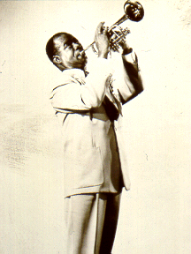
And I think to myself,

Slide 34

what a wonderful world

Slide 35
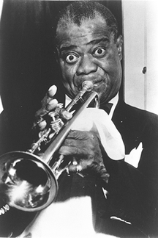
Yes, I think to myself,

Slide 36
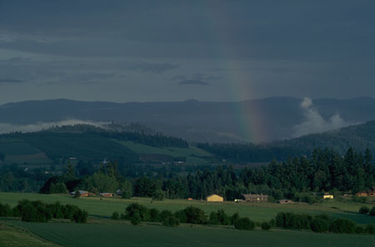
what a wonderful world.

Slide 37

Oh, Yeah!
Thanks for attending the Tech Brown Bag! !

